Slide 1
Partnership Wild and Scenic Rivers
Proposed for Segments of the Nashua, Squannacook & Nissitissit Rivers
Presentation to Partner Communities
Status report: on the work of the Nashua River Wild and Scenic Rivers
Study Committee

Slide 2
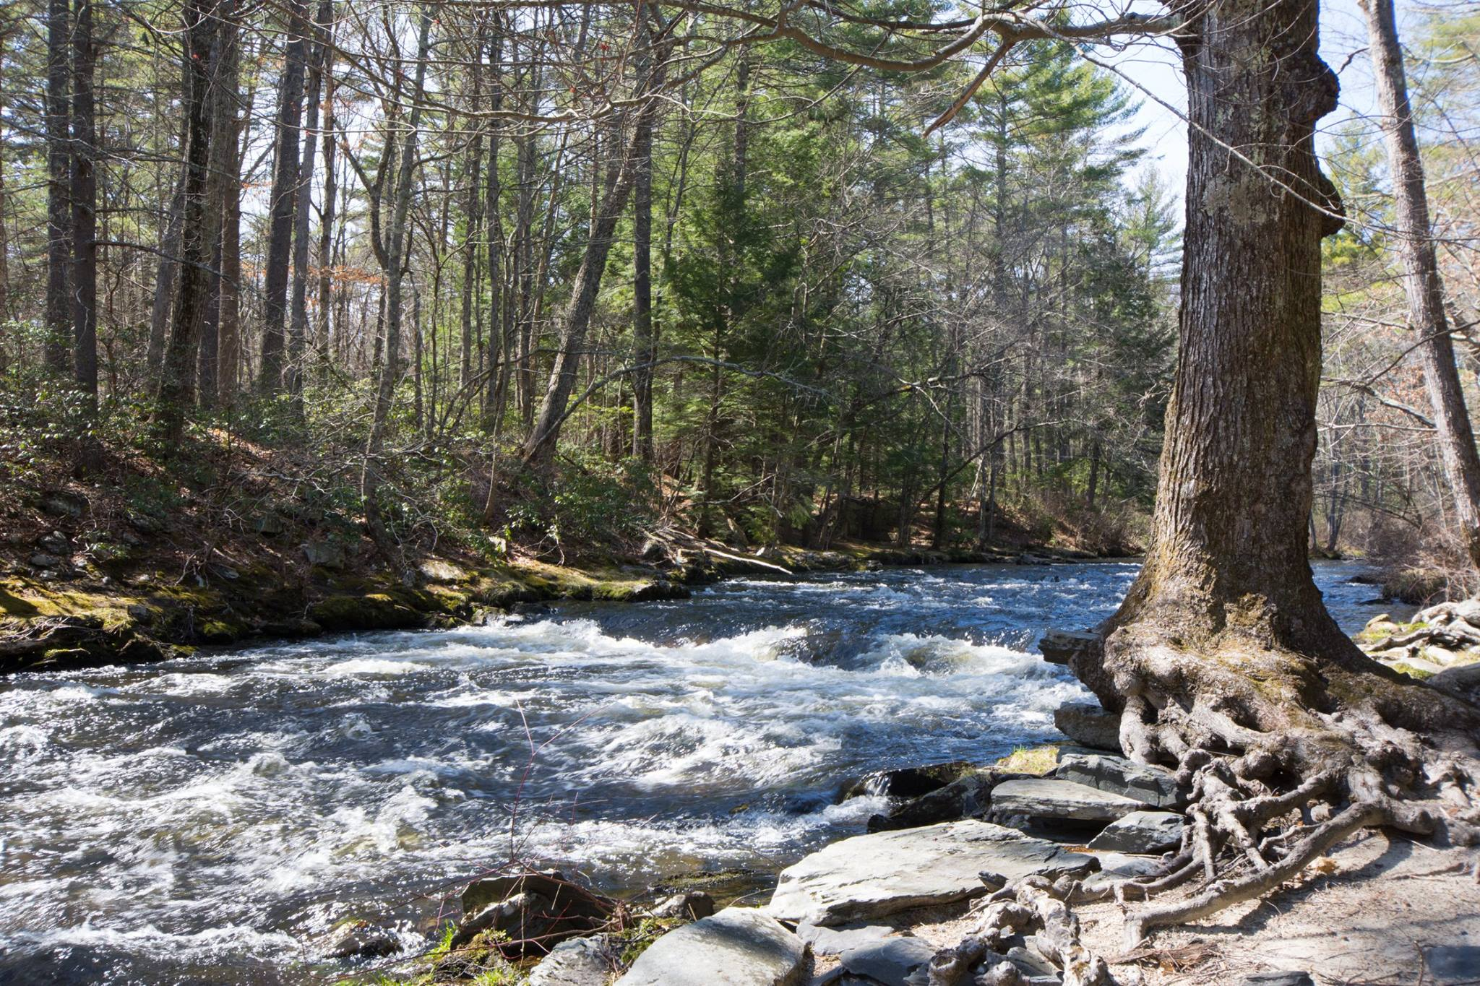
Squannacook River – West Groton

Slide 3
Boards of Selectmen of Ayer, Bolton, Brookline, Dunstable, Groton, Harvard, Hollis, Lancaster, Shirley, Townsend, & Pepperell have voted to endorse the Study. The Study was authorized by Congress, which Congresswoman Tsongas publically announced in January 2015.

Slide 4
What is a Wild and Scenic River Study?
Congressionally authorized Study to determine whether a river segment is eligible and suitable for designation.
Based on 1968 Wild & Scenic Rivers Act to protect and restore the nation’s best rivers. Presently, 170+ rivers designated.
Conducted by Study Committee with much public input; ~3 years to finish Study.
Develops a River Management Plan to protect and restore the outstanding resources of these rivers.

Slide 5
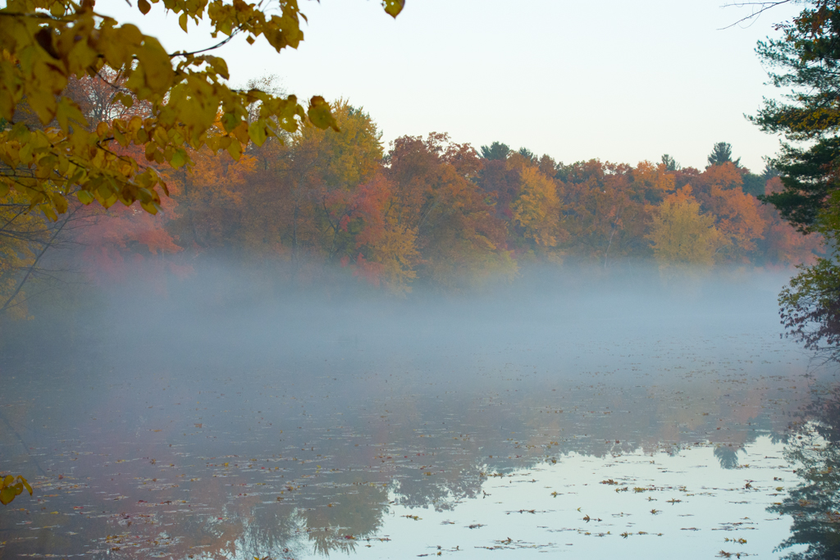
Nashua River - Groton

Slide 6
The Nashua River Study Committee consists of a representative and an alternate appointed by the participating towns’ BoS.
Current Study Committee members are:
Ayer Beth Suedmeyer (rep) & Robert Pontbriand (alt)
Bolton Rona Balco (rep) & Rebecca Longvall (alt)
Brookline Jordan Bailey (rep) & Drew Kellner (alt)
Dunstable Leah Basbanes (rep) & Judy Larter (alt)
Groton Nadia Madden (rep) & Tim Newman (alt)
Hollis LeeAnn Wolff (rep) and Laura Bianco (alt)
Harvard Lucy Wallace (rep)
Lancaster Bill Flynn (rep) & Susan Munyon (alt)
Pepperell Paula Terrasi (rep) & Mark Andrews (alt)
Shirley Heidi Ricci (rep) & Betsy Colburn (alt)
Townsend Bill Wilkinson (rep)
Other voting committee members include representatives from National Park Service and Nashua River Watershed Association.
Non-voting members include representatives from MA Div. of Ecological Restoration, MA Dept. of Fish & Game, US Fish & Wildlife Service and US Geological Survey.
Participating guests include local and regional resource experts and stakeholders from Massachusetts and New Hampshire.

Slide 7
What Parts of the Rivers are Being Considered?
River Segment 1:
Nashua River Mainstem: from the Confluence of the North and South Nashua Rivers in Lancaster to state line at Pepperell/ Dunstable with four mile stretch of Pepperell Pond informally participating.
River Segment 2:
Squannacook River: from the headwaters in Townsend to its confluence with Nashua River Mainstem in Shirley/ Ayer.
River Segment 3:
Nissitissit River: from state line to its confluence with Nashua River Mainstem in Pepperell with upper reach from Lake Potanipo in Brookline, NH to MA state-line informally participating.

Slide 8
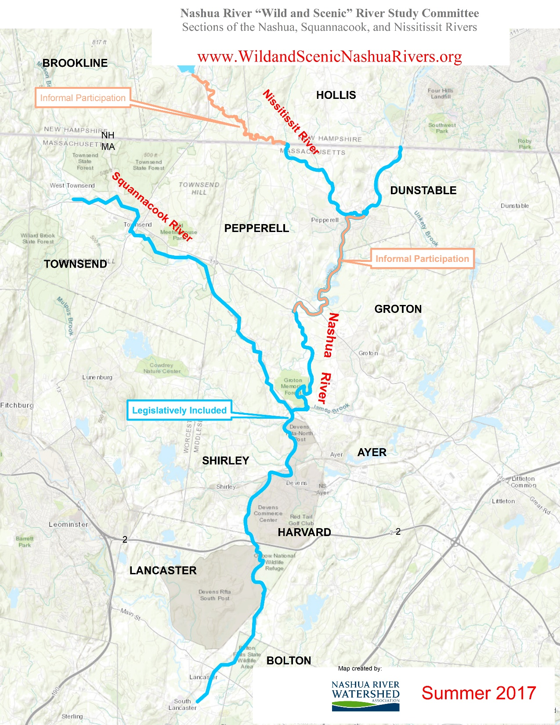

Slide 9
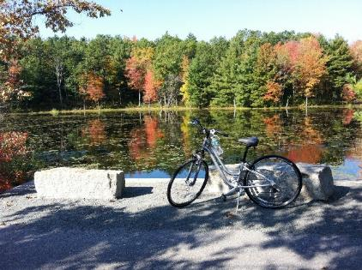
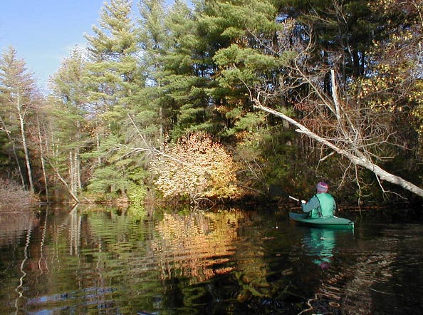
What is so special about these rivers? Outstandingly Remarkable Resource Values
Recreation e.g: boating, trout stocking, bass fishing tournament.
Scenic & natural landscapes.
Ecological values including cold-water fisheries, ACECs, biodiversity & habitat.
Local cultural & industrial history e.g: reversal of Nashua from top 10 most polluted rivers in US.

Slide 10
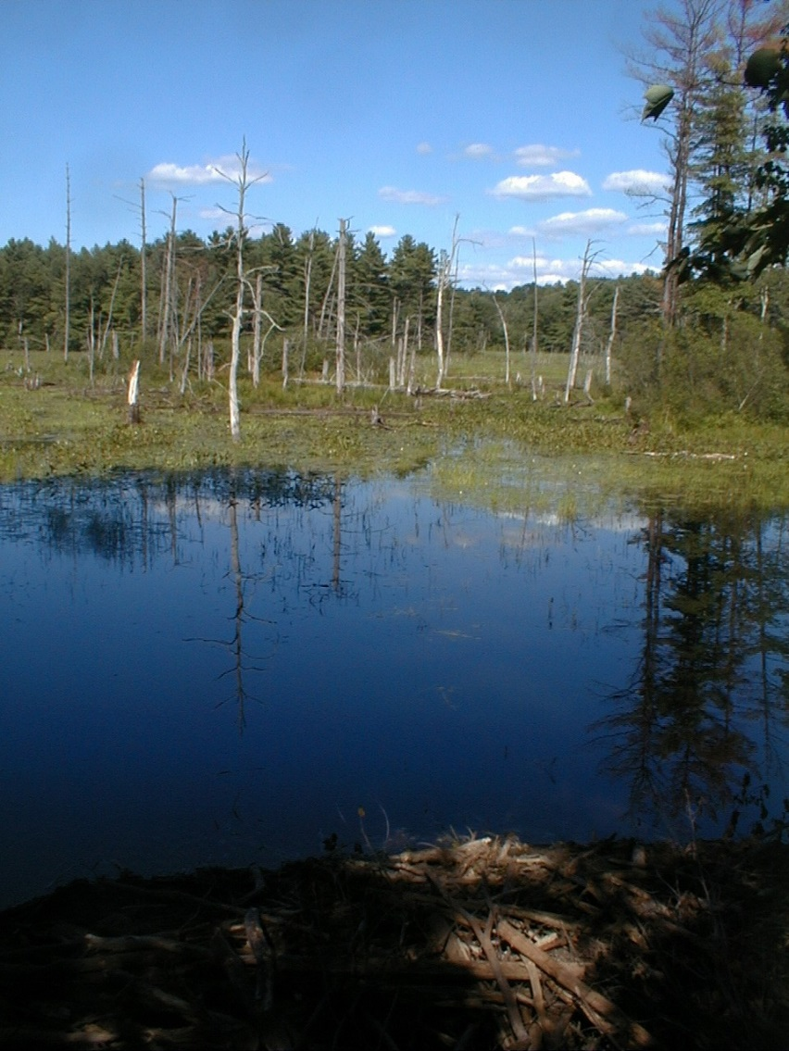
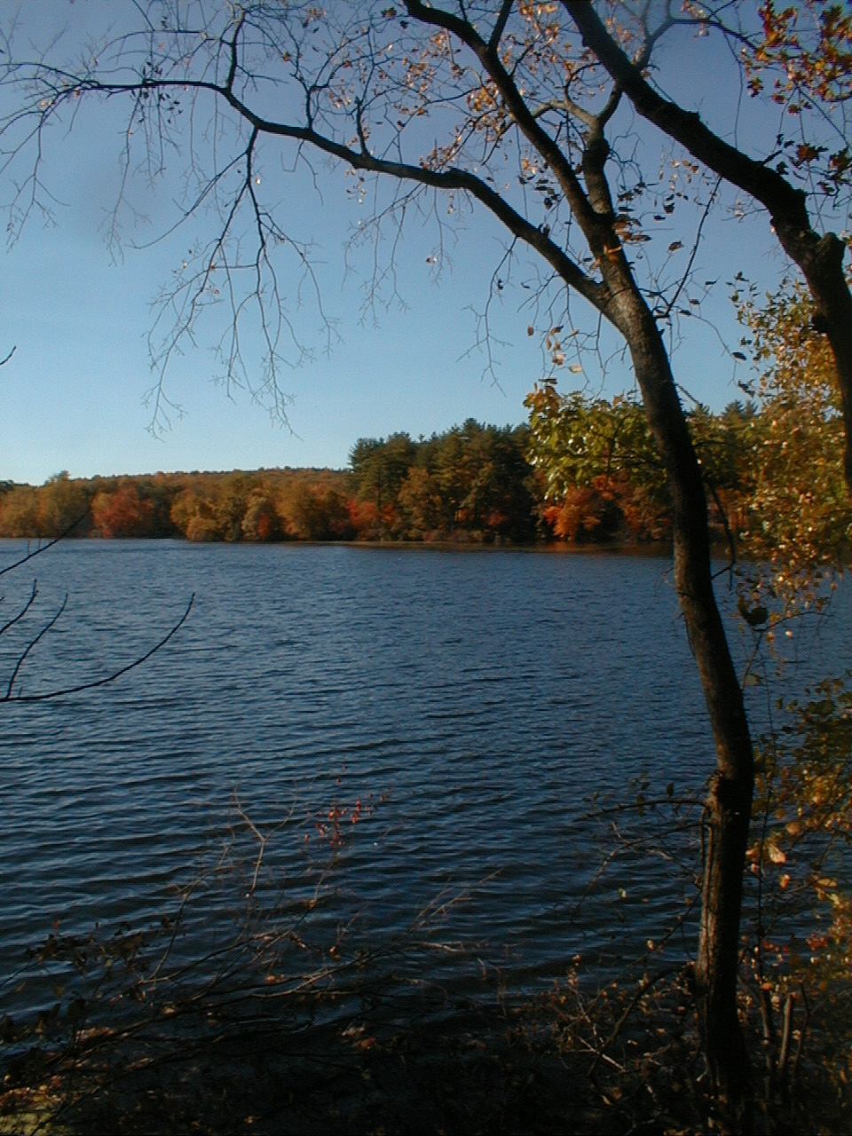
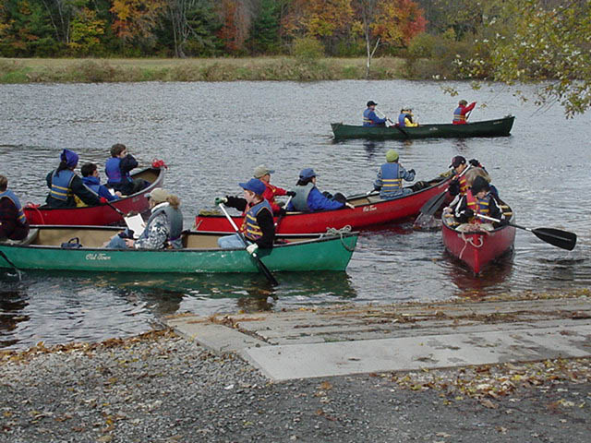

Slide 11
Why is the Wild and Scenic River Study itself so valuable?
Opportunity for towns along these rivers to work together to protect their shared regional resources.
Provides towns with structure, expertise and funding to identify needs, set goals and implement the Management Plan to maintain & protect these rivers.
Entirely voluntary & locally determined process.

Slide 12
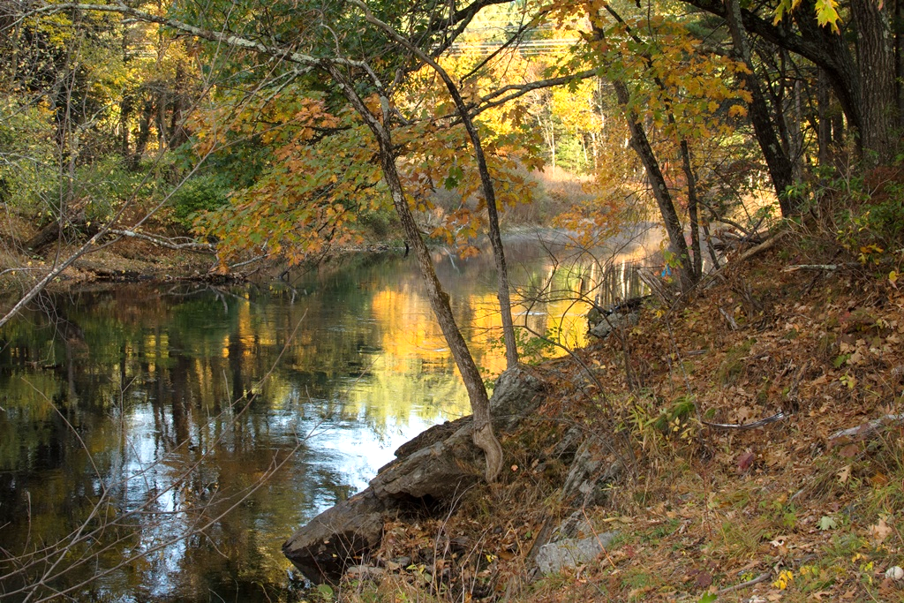
Nashua River - Ayer

Slide 13
What would Wild & Scenic designation achieve?
Granted only if Study process demonstrates both outstanding resources & local commitment to protect them.
Prohibits new federally-licensed dams and harmful diversions. Ensures no adverse impacts from future federally-funded /-permitted water resource projects.
Directed by a locally-based “coordinating council,” which would oversee river management plan implementation through voluntary measures.
Qualifies these river segments for annual federal NPS funds. And, Wild and Scenic status often leverages additional funds (eg: priority status on grant applications).

Slide 14
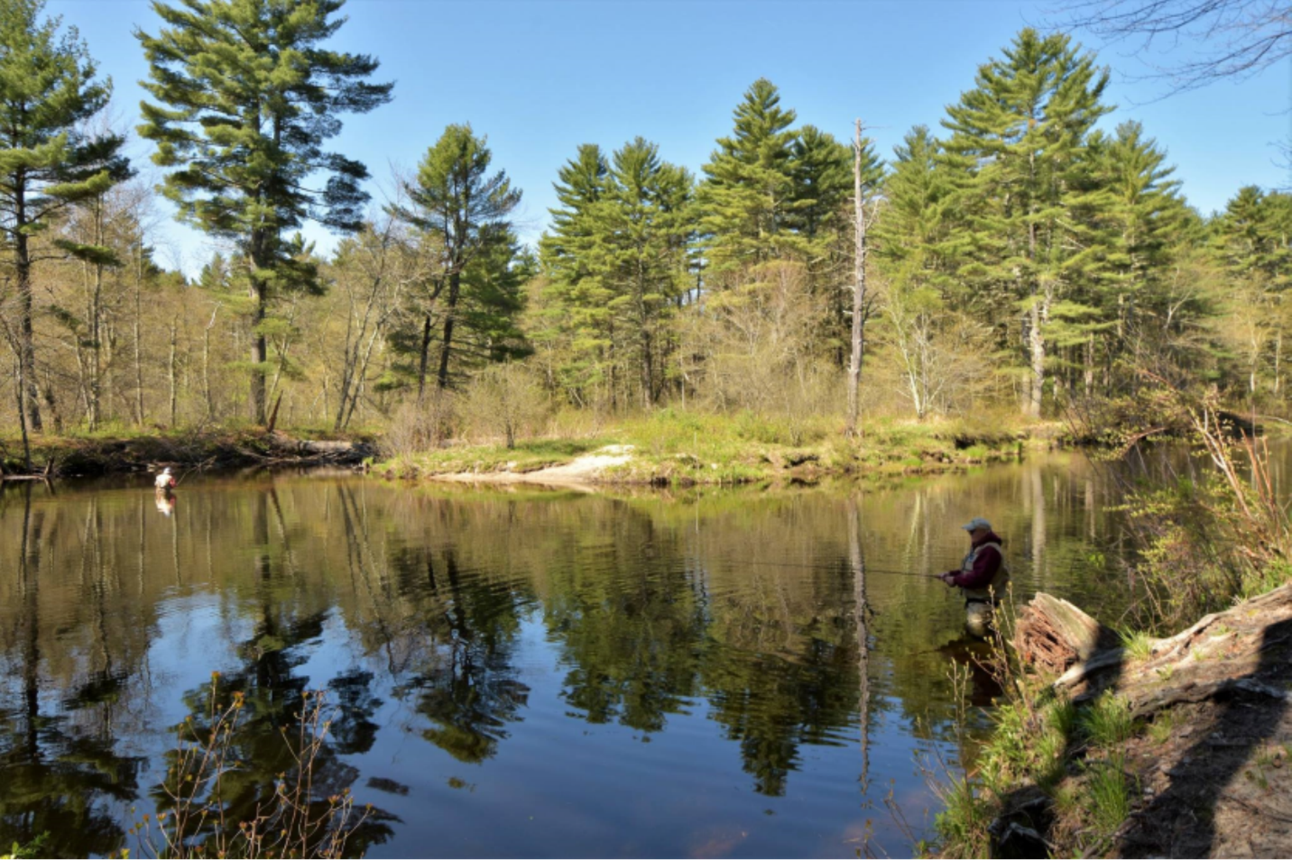
Nissitissit River – Pepperell

Slide 15
What the Study and Designation DOES NOT DO:
Does not:
lead to federal acquisition, establish a federal park or put land under federal control, force any changes in the local process of land-use decision- making, nor change any existing land uses.
No impact on existing dams.
No affect on hunting and fishing laws.
No restricted river access & does not require public access to private land.

Slide 16
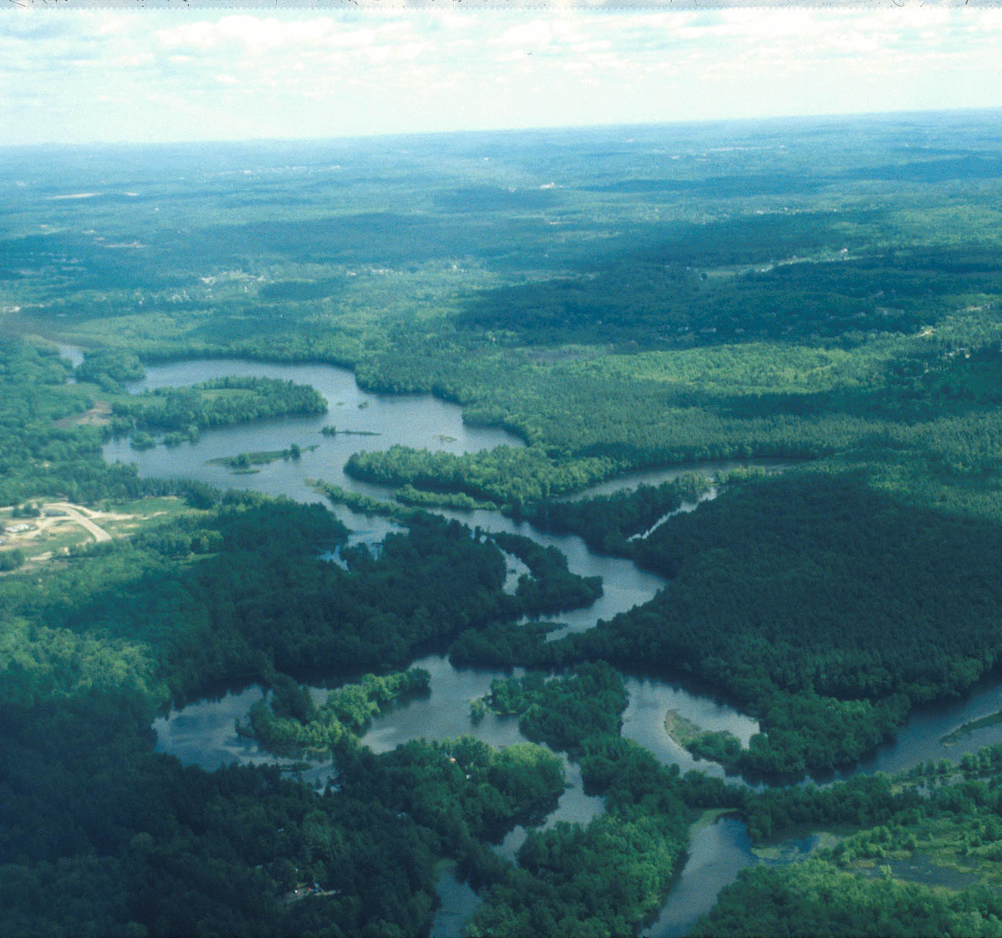

Slide 17
Next Steps for the Study Committee
Outreach & Outstandingly Remarkable Resource Values sub-committees will reach out to town boards, interested individuals & local organizations to gather relevant information.
Drafts of Study Committee’s work--the draft Management Plan-- will be publically shared for further input and feedback.
Each town’s BoS must vote to put the draft Management Plan on their town’s meeting agenda along with the topic of Designation.
Formal town spring 2018 Annual Meeting votes in participating towns to determine whether towns agree with Designation and accept the draft Management Plan.

Slide 18
Nashua River - Harvard

Slide 19
Questions?

Slide 20
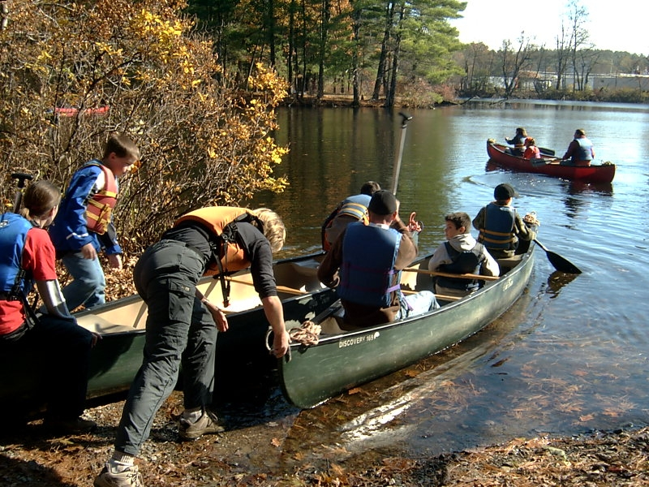
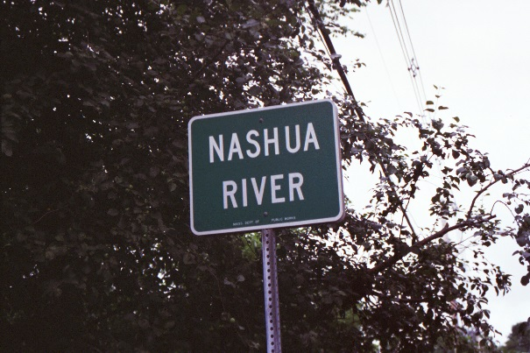
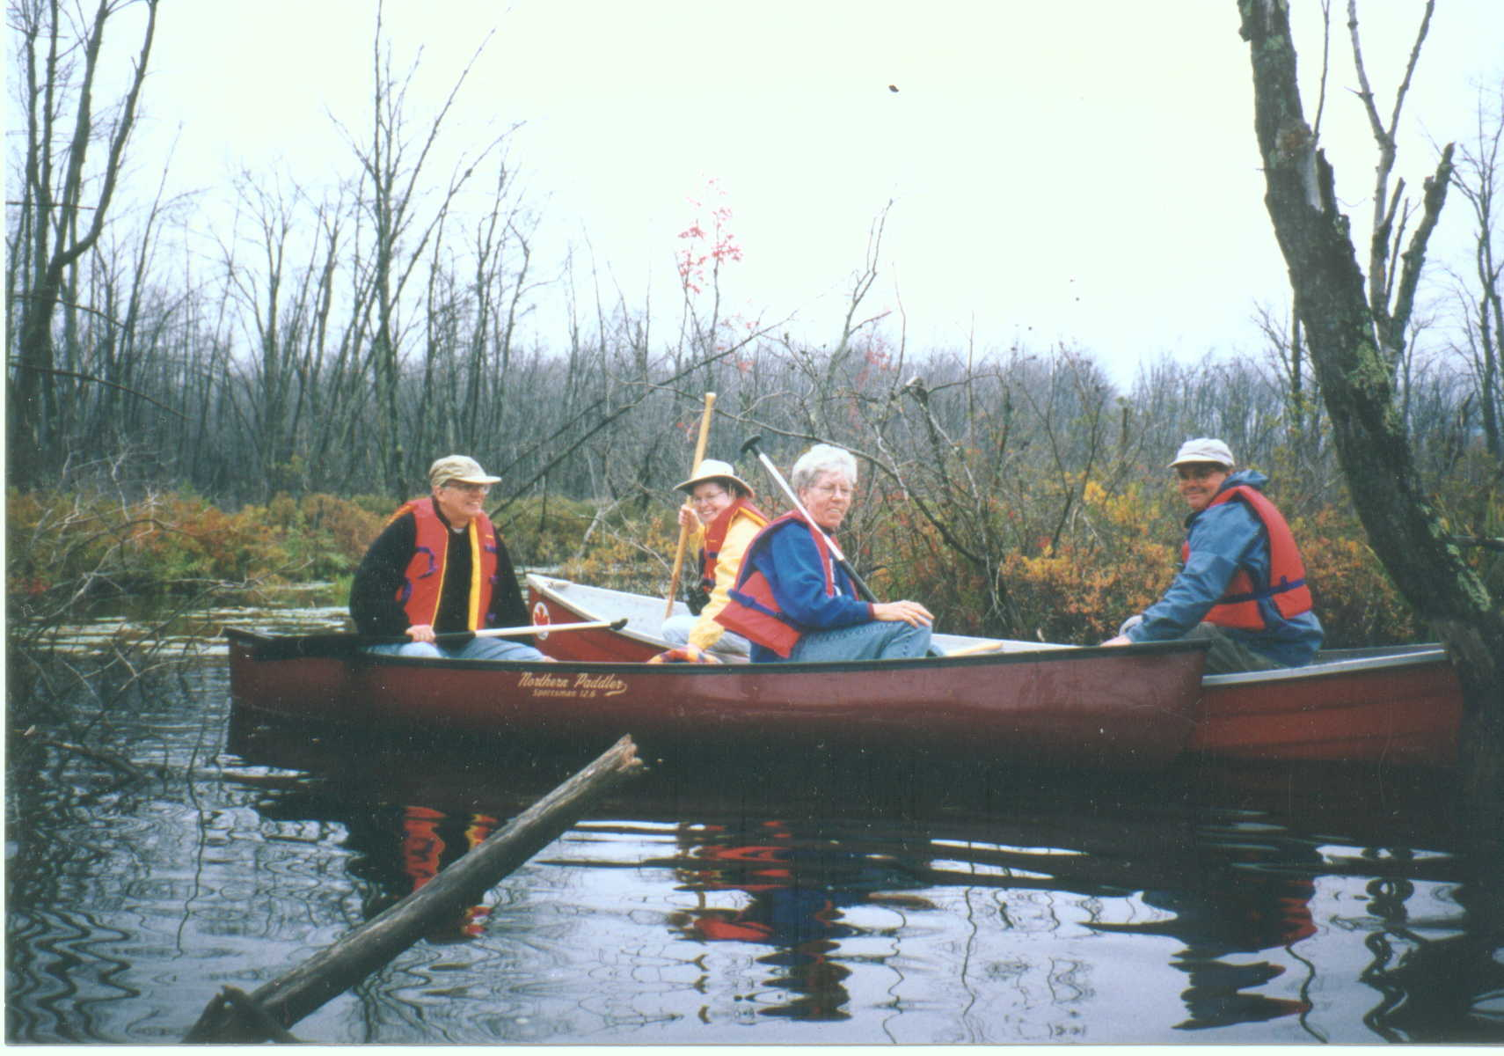
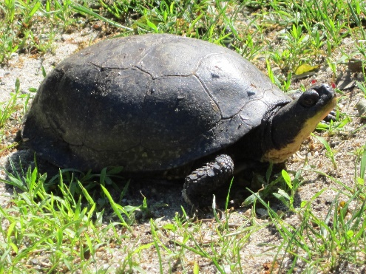
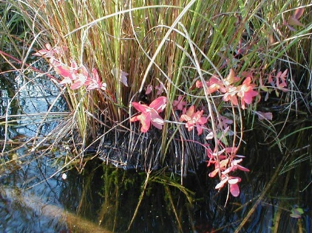

Slide 21
CONTACT US
See http://WildandScenicNashuaRivers.org
At Nashua River Watershed Association (NRWA)
Al Futterman, Land Programs and Outreach Director
(978) 448-0299
At National Park Service (NPS)
Jamie Fosburgh, Northeast Region Rivers Program New England Team Leader
(617) 223-5191

Slide 22
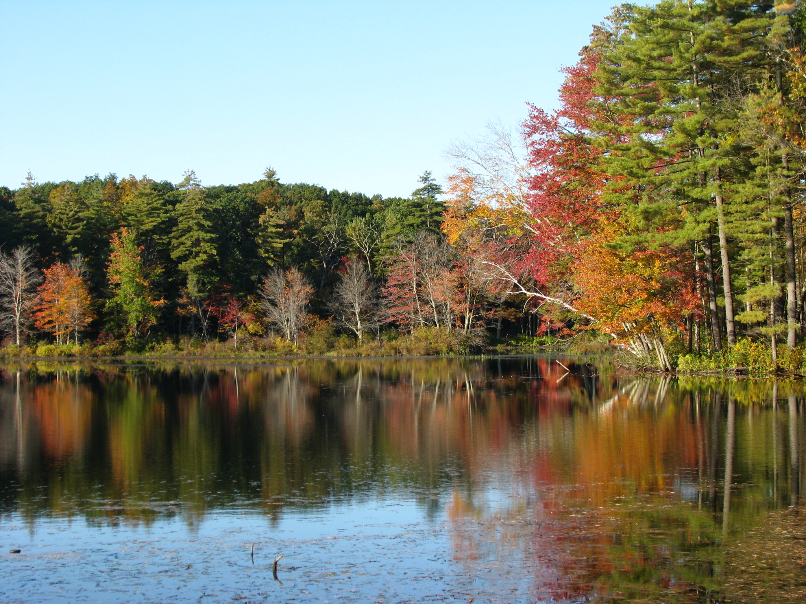
Photo Credits for Slides x, v, y: Cindy Knox. Photo Credits for Slides x, v: NRWA Archives.

